Slide 1
Reddit Random Acts of Pizza

Slide 2

Introduction
Reddit provides a forum where people can post why they want a free pizza delivered by Reddit.
The goal is to create a machine learning algorithm that can predict the types of posts that receive free pizza.

Slide 3
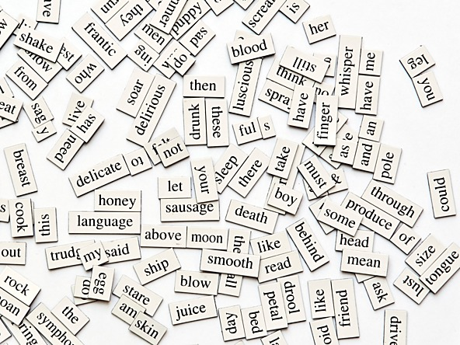
Dataset
5671 Requests collected from the Reddit community between December 2010 and September 2013.
Labeled data provided indicating outcome of each request.
Data fields include time of request, activity of requester, community-age of requester, request text, downvotes of request, upvotes of request, post number of comments

Slide 4
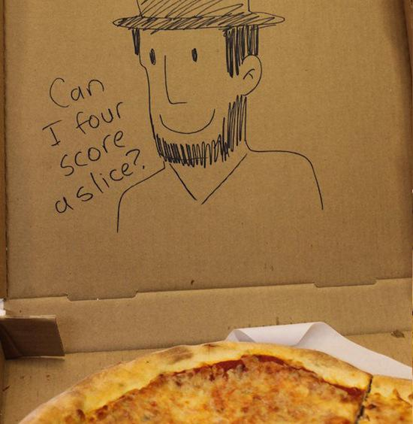
Features in Model
Request text– using text mining to derive patterns from request.
Numerical variables – Incorporating quantitative variables such as number of comments, number of votes

Slide 5
Modeling Prep
In order to build a model, the first preparation step is to break up the training dataset into its own test and train datasets.
75% of the data will be used to build the model, and the other 25% of the data will be used to check the accuracy of the model.
A 75/25 random split is done to create the ‘train’ and ‘test’.
“Train”
“Test”
“test”
“train”

Slide 6
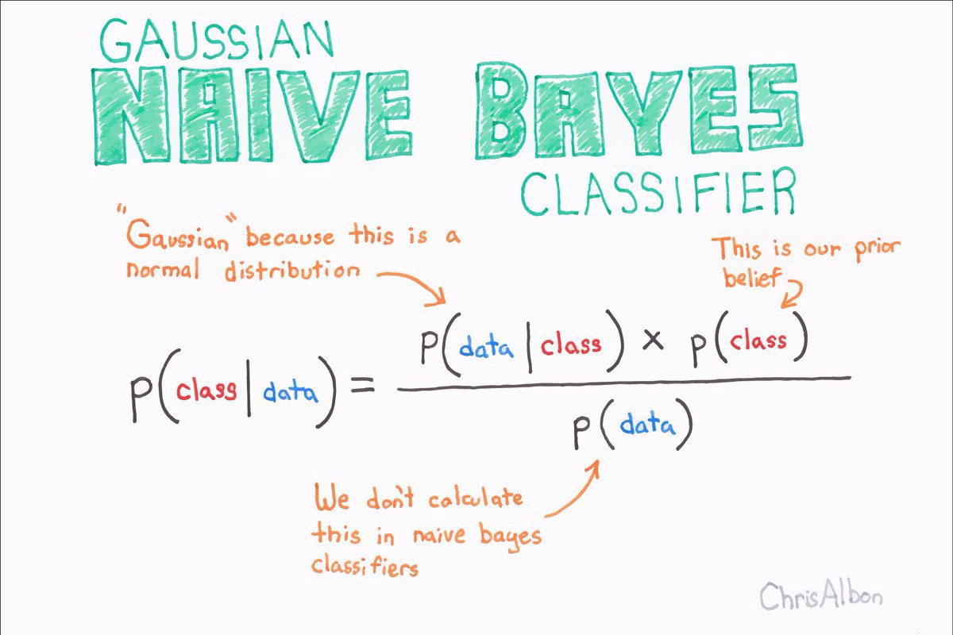
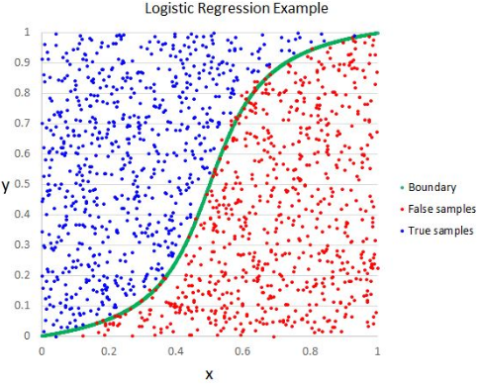
Methods
There are two applications of machine learning that are applied to the data.
For the text data, a naïve bayes classifier is most appropriate.
Naïve bayes uses the Bayes theorem and predicts probabilities for a given record belonging to each class.
Naïve bayes works better on integer values.
Text data is sparse. There are thousands of rows with values ranging from 0 to 4, where over 90% of the values are 0.
Commonly used method for bag-of-words model.
For the numeric data, a logistic regression is most appropriate.
Logistic regression explains the relationship between a dependent binary variable and many features.

Slide 7
Part 1 – Text Data Model

Slide 8

Text Feature Extraction – Method 1
Only words in successful requests were considered for feature selection.
Bag of Words – each word represents a feature. Grammar and order are disregarded. The frequency of each word is stored.
Using NLTK python module
Stop words – noise in text. Words such as “is”, “are”, “am”, etc. removed.
Stemming – all words were derived to its word stem.
Frequency of words greater than 1, and words longer than two letters were kept as features.

Slide 9
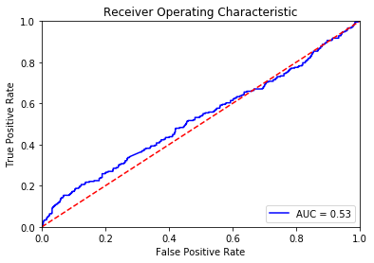
Text Feature Extraction – Method 1 Results
 | precision | recall | f1-score | support
False | 75% | 93% | 0.83 | 743
True | 43% | 15% | 0.23 | 267
avg / total | 67% | 72% | 0.67 | 1010
Final Accuracy: 72%
Precision/Recall:
ROC Curve:
Conclusion: Model has poor predictive power.

Slide 10
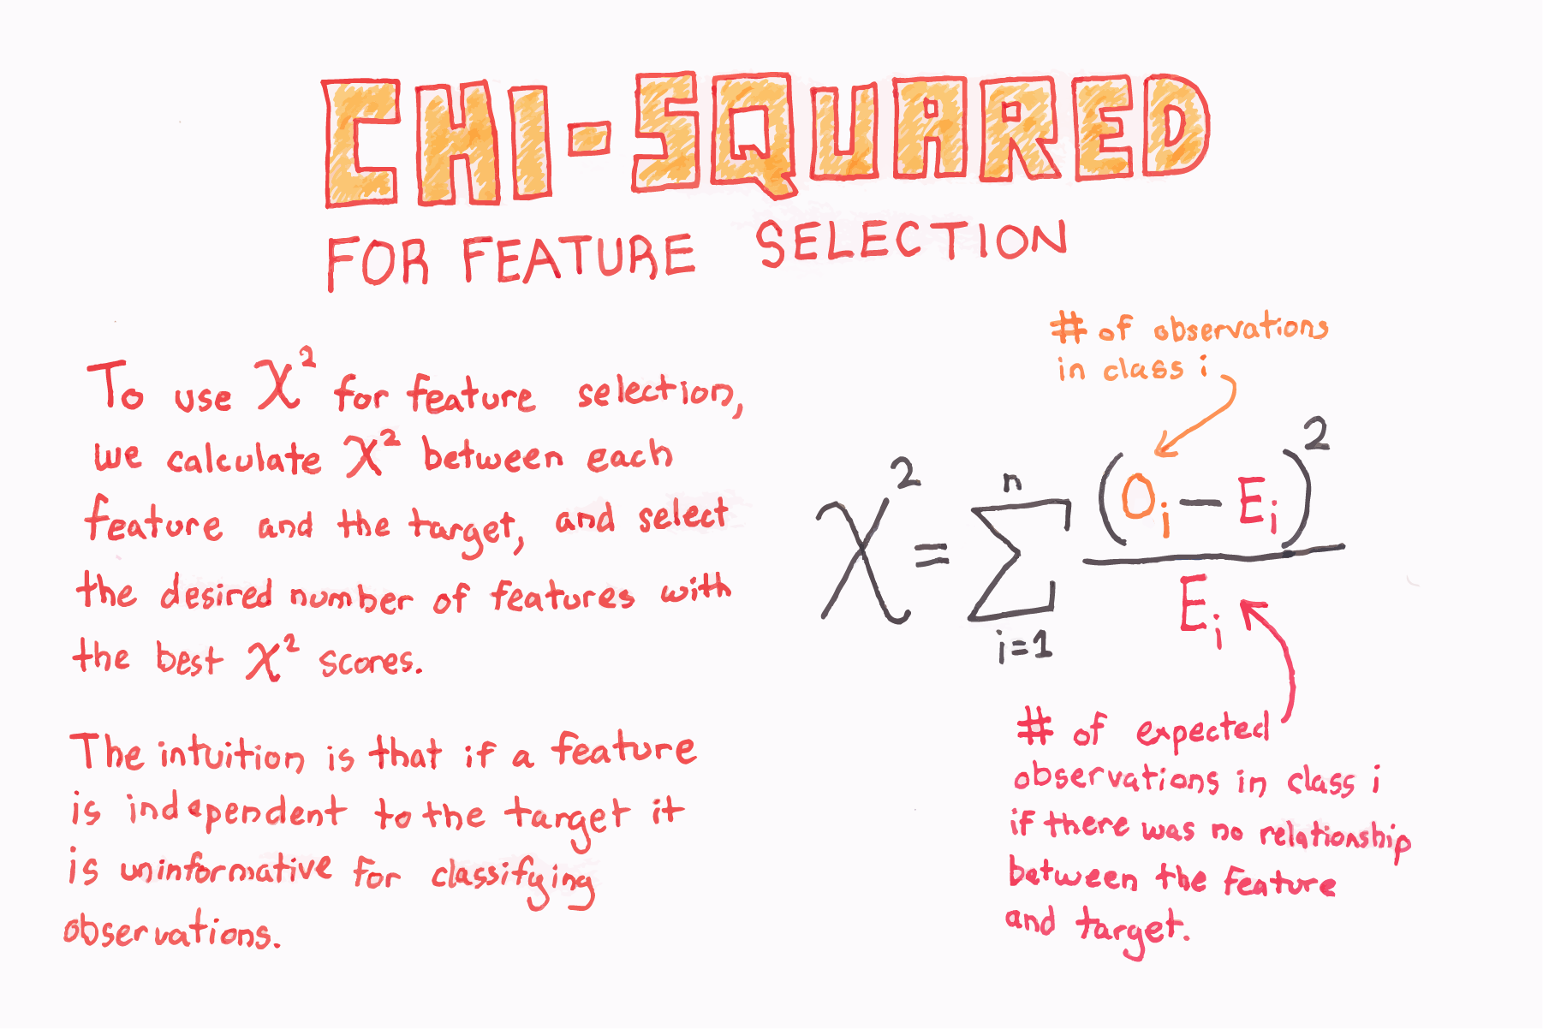
Text Feature Extraction – Method 2
Bag-of-words: One column for each word, values in each column represented by word counts for each record. Same cleaning methods applied in method 1 were also applied in method 2 (stop words, stemming)
Chi square feature selection to reduce columns.
Popular feature selection method for text mining.
Uses the chi square test of to determine the dependency of two variables.
If the feature variable is independent of the labeled value, then that feature is discarded.

Slide 11
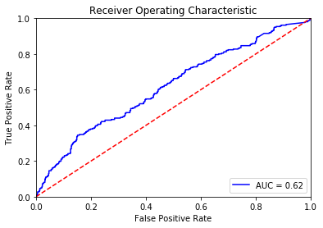
Text Feature Extraction – Method 2 Results
Final Accuracy: 34%
Precision/Recall:
ROC Curve:
Conclusion: Model has poor predictive power.
 | precision | recall | f1-score | support
False | 84% | 14% | 0.24 | 749
True | 27% | 92% | 0.42 | 261
avg / total | 69% | 34% | 0.29 | 1010

Slide 12
Comparison Method 1 + Method 2 Text Models
 | Method 1 – Bag-of-words + frequency counts feature selection |  |  |  | Method 2 – Bag-of-words + chi square feature selection
 | precision | recall | f1-score | support | precision | recall | f1-score | support
False | 75% | 93% | 0.83 | 743 | 84% | 14% | 0.24 | 749
True | 43% | 15% | 0.23 | 267 | 27% | 92% | 0.42 | 261
avg / total | 67% | 72% | 0.67 | 1010 | 69% | 34% | 0.29 | 1010
AUC | 0.53 |  |  |  | 0.62
Accuracy | 72% |  |  |  | 34%
Comments | Of the predicted pizza requests, 75% of the false predictions were accurately predicted, and 43% the true predictions were accurately predicted. Of actual pizza requests granted, the model predicted false pizza requests 93% of the time, and true pizza requests 15% of the time. |  |  |  | Of the predicted pizza requests, 84% of the false predictions were accurately predicted, and 27% the true predictions were accurately predicted. Of actual pizza requests granted, the model predicted false pizza requests 14% of the time, and true pizza requests 92% of the time.

Slide 13
Part 2 – Numeric Data Model

Slide 14
Numeric Data
At Request – Variable at time of pizza request | At Retrieval – Variable at time request was collected
Number of Downvotes – Dislike/Disagree
Number of Upvotes – Like/Agree
Post was edited (neither at request/at retrieval)
Number of Comments
Account Age in Days
Days since First Post
Upvotes - Downvotes
Upvotes + Downvotes

Slide 15
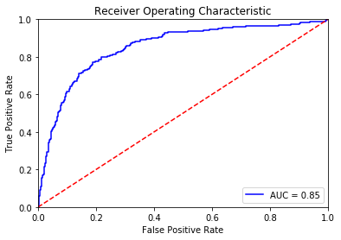
Model
Logistic Regression was used to predict the pizza request outcome.
Final Accuracy: 83%
Precision/Recall:
ROC Curve:
Conclusion: Model has significant predictive power.
Of the predicted pizza requests, 86% of the false predictions were accurately predicted, and 68% the true predictions were accurately predicted. Of actual pizza requests granted, the model predicted false pizza requests 94% of the time, and true pizza requests 47% of the time.
 | precision | recall | f1-score | support
False | 86% | 94% | 0.89 | 780
True | 68% | 47% | 0.55 | 230
avg / total | 69% | 83% | 0.82 | 1010

Slide 16
Should Models be Combined?
No- the text models have flaws. The text model using method 1 is good at predicting false pizza requests, and poor at predicting true pizza requests. Text model using method 2 is good at predicting true pizza requests, and poor at predicting false pizza requests. Therefore method 1 has an underfitting problem and method 2 has an overfitting problem. Although the logistic model has more predictive power than the text models, the accuracy could be improved. Therefore, although the numeric model would benefit from adding another model of predictive power, both text models would lower the overall result when added with the numeric model.

Slide 17
Possible Reasons for Unsuccessful text Models
Human behavior is unpredictable
No knowledge of viewpoints/opinions of humans granting pizza requests
Multiple humans are granting pizza requests = multiple opinions
Difficult to distinguish a pattern amongst pizza requests. Successful requests range from “I don't have much to offer but if you can help me out I'll owe you big. My stomach is growling I have some water and about 2 dollars in change. This pizza would last me a few days until my check comes in.” to “"I like pizza, you like pizza. PIZZA?”

